Slide 1
Superstore Sales Prediction
Final Project
Data Science Foundation
April 2023

Slide 2
Section 1: Business Understanding
April 2023

Slide 3
Business Understanding
Background
The retail industry is highly competitive, and companies are constantly looking for ways to improve sales and stay ahead of the competition. One approach they take is to leverage data analytics and machine learning to gain insights into consumer behavior and preferences.
Problem Statement
To forecast the sales of retail shop goods based on a variety of product and outlet features in order to learn more about customer behaviour and preferences and increase overall revenue.
Objective
To create a model that forecasts Item Outlet Sales by several categories, various performance metrics such as mean absolute error (MAE) and root mean squared error (RMSE) will be used to evaluate the model's performance. Based on the model's learned insights, data-driven decisions will be made to improve sales success and profitability.

Slide 4
Section 2: Data Understanding
April 2023

Slide 5
Data Capture and Explanation
Information on products and their sales is included in the dataset utilized for this study. The downloaded dataset was chosen from Kaggle.com.
For the general understanding of the dataset, we investigated the structure and information of it and plotted graphs to understand the distribution of the same.

Slide 6
Data Capture and Explanation
Features:
Item_Identifier: Each item is assigned a unique code.
Item_Weight: The weight of the item.
Item_Fat_Content: Specifies whether an item is regular or low fat.
Item_Visibility: The percentage of total display area allotted to a particular item in a shop.
Item_Type: The categorization of the item.
Item_MRP: Maximum list price of the item.(in Dollars)
Outlet_Identifier: Each outlet is assigned a unique code.
Outlet_Establishment_Year: The establishment year of the outlet.
Outlet_Size: The outlet's size in terms of ground area covered.
Outlet_Location_Type: The city/town in which the outlet is located.
Outlet_Type: Whether the establishment is a chain or not, a grocery store, or a supermarket.
Item_Outlet_Sales: The item's sales in that particular outlet

Slide 7
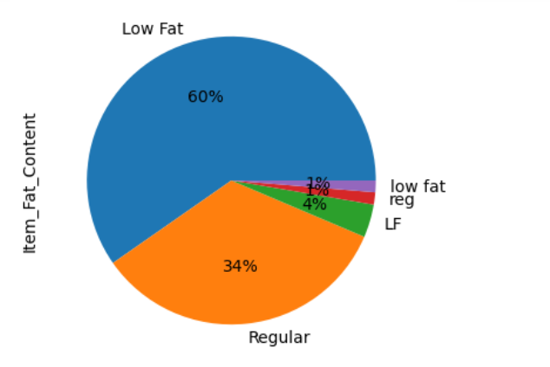
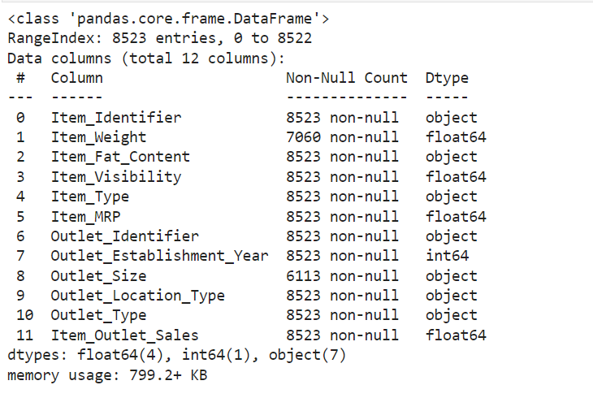
Data Exploration
Before starting with any analysis, it is always recommended to explore the data and check how to data can be improved to increase the efficiency of the prediction.
Observation: In the Item_Fat_Content feature we could see that Low Fat is also mentioned as LF and low fat which needs to be fixed.
Observation: Values are MISSING in the feature Item_Weight and Outlet_Size

Slide 8
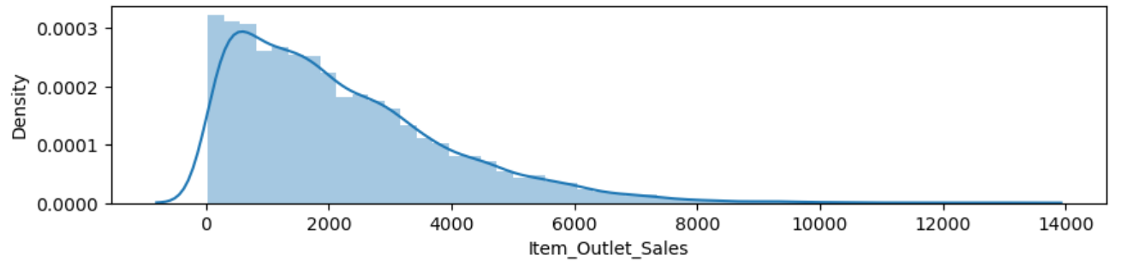
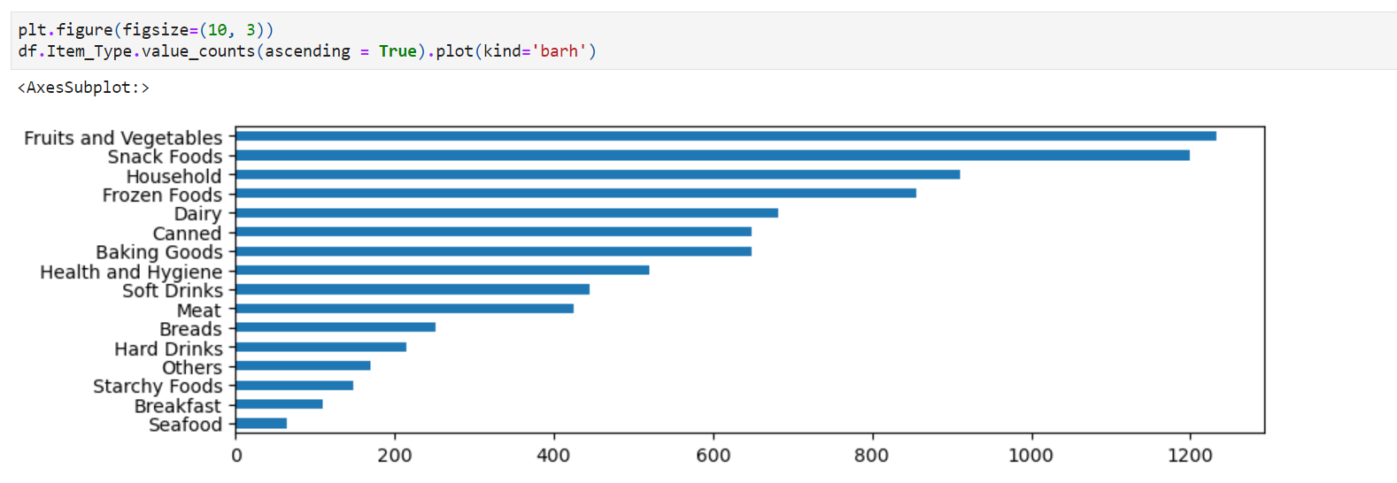
Data Exploration
Observation: The sales data is positively skewed. This shows a positive trend that the high value sales are less, and healthy sales amounts is between 0 and 2000
Observation: Fruits and vegetables are the topmost selling products followed by snack foods and household products Starchy foods, breakfast and seafood are the least selling products

Slide 9
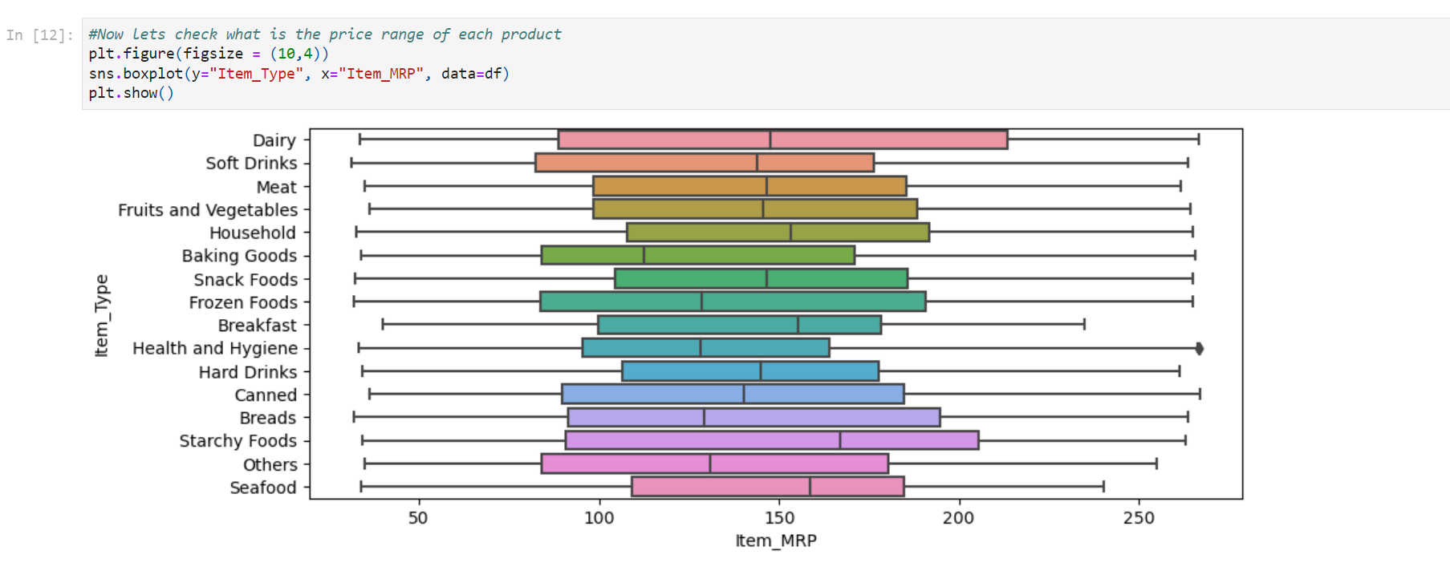
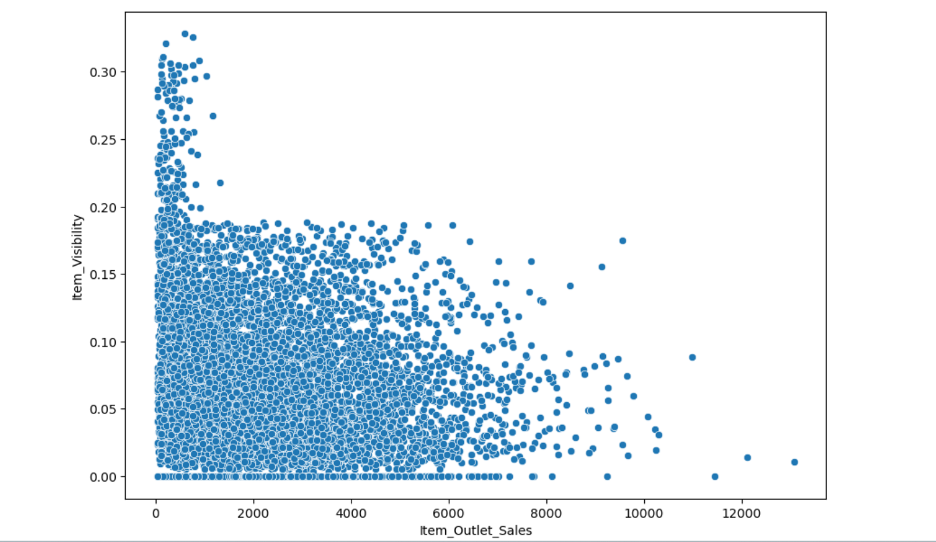
Data Exploration
Observation: All of the products range from between 80 to 180
Observation: Lower visible products are generating sales, but the sales generated by highly visible products is more

Slide 10
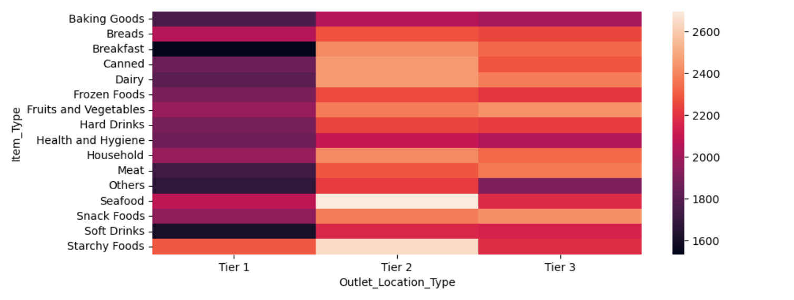
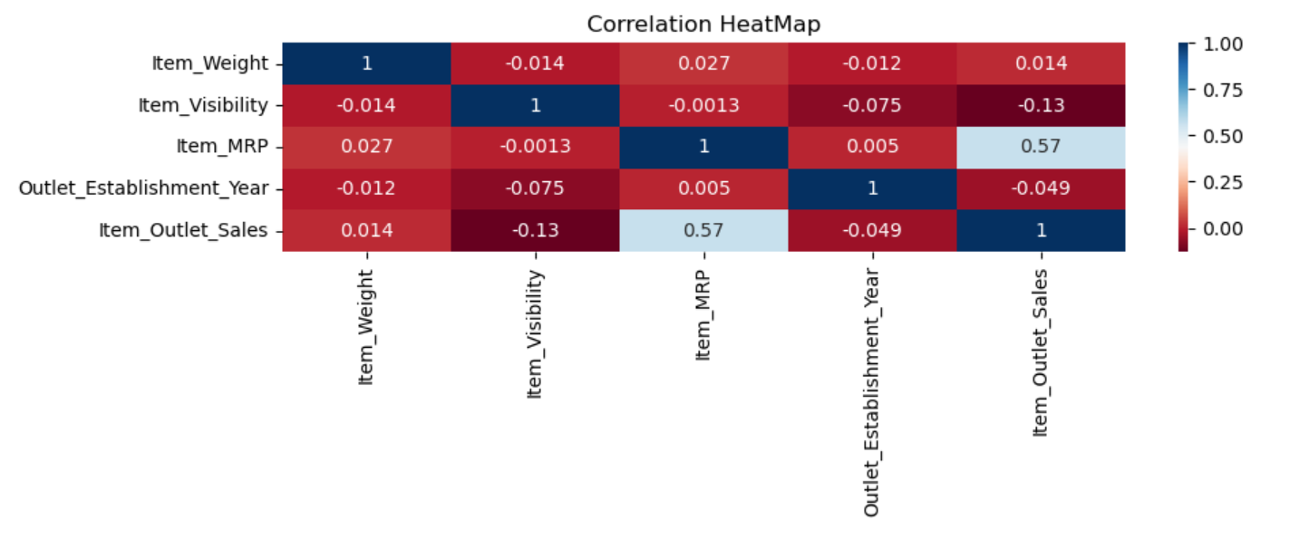
Data Exploration
Observation:
1. This intensity map clearly shows that Tier 1 is doing well in Sales for all the products
2. Soft drinks and Breakfast make the most of the sales there
3. Seafood and Starchy food makes the least sale in Tier 2
Observation:
From here it can be seen that the 'Item_MRP' AND 'Item_Outlet_Sales' are somewhat correlated, but still its not a very strong correlation, hence it is not a good idea to drop any of these.

Slide 11
Section 3: Data Preparation
April 2023

Slide 12
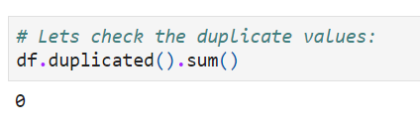
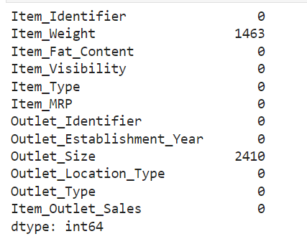
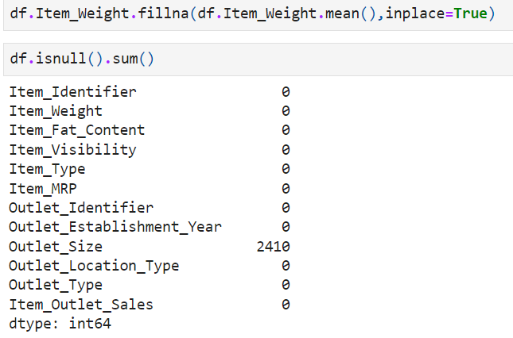
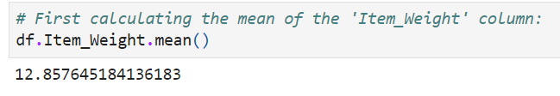
Data Preparation and Feature Engineering
No duplicates found
Observation:
Missing values were replaced with the mean score for the feature Item_Weight

Slide 13
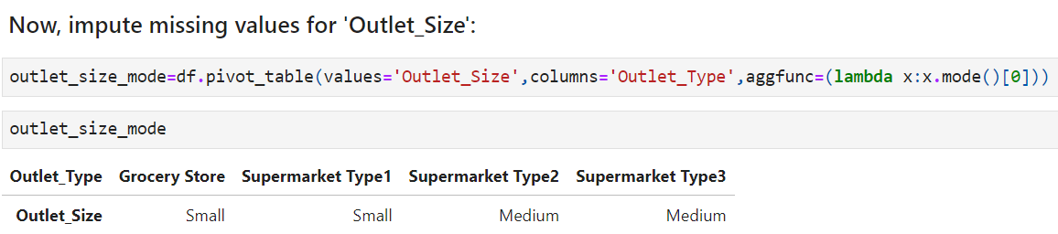
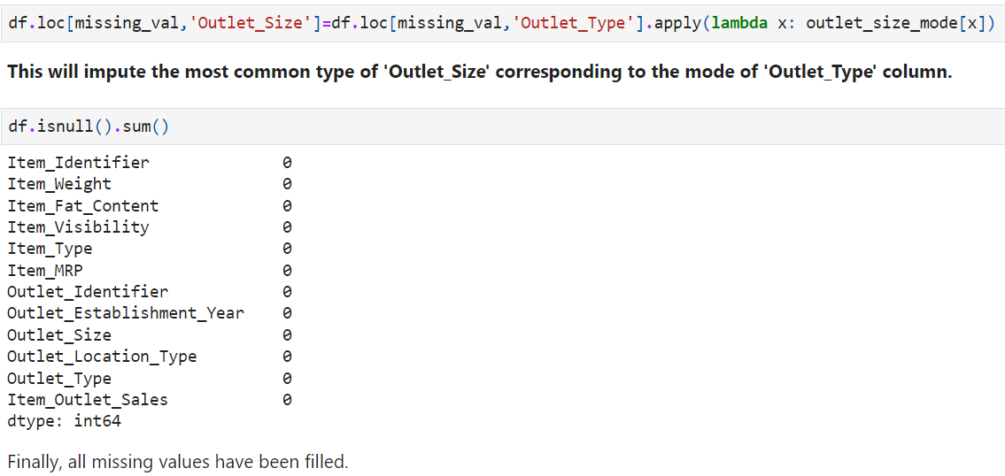
Data Preparation and Feature Engineering
Observation:
The mode of each type of store is being calculated first and then that value is being imputed in the missing values.
This approach is much better than finding the mode of the entire column and then replacing it with the missing values.
This imputes the most common type of 'Outlet_Size' corresponding to the mode of 'Outlet_Type' column.

Slide 14
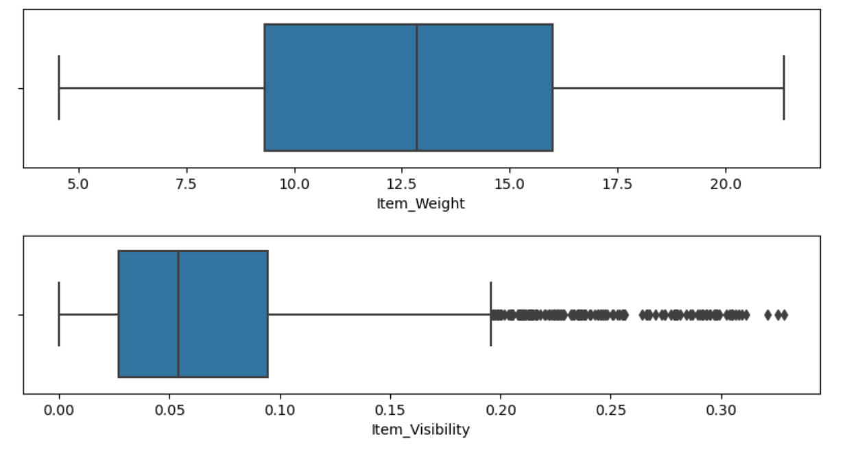
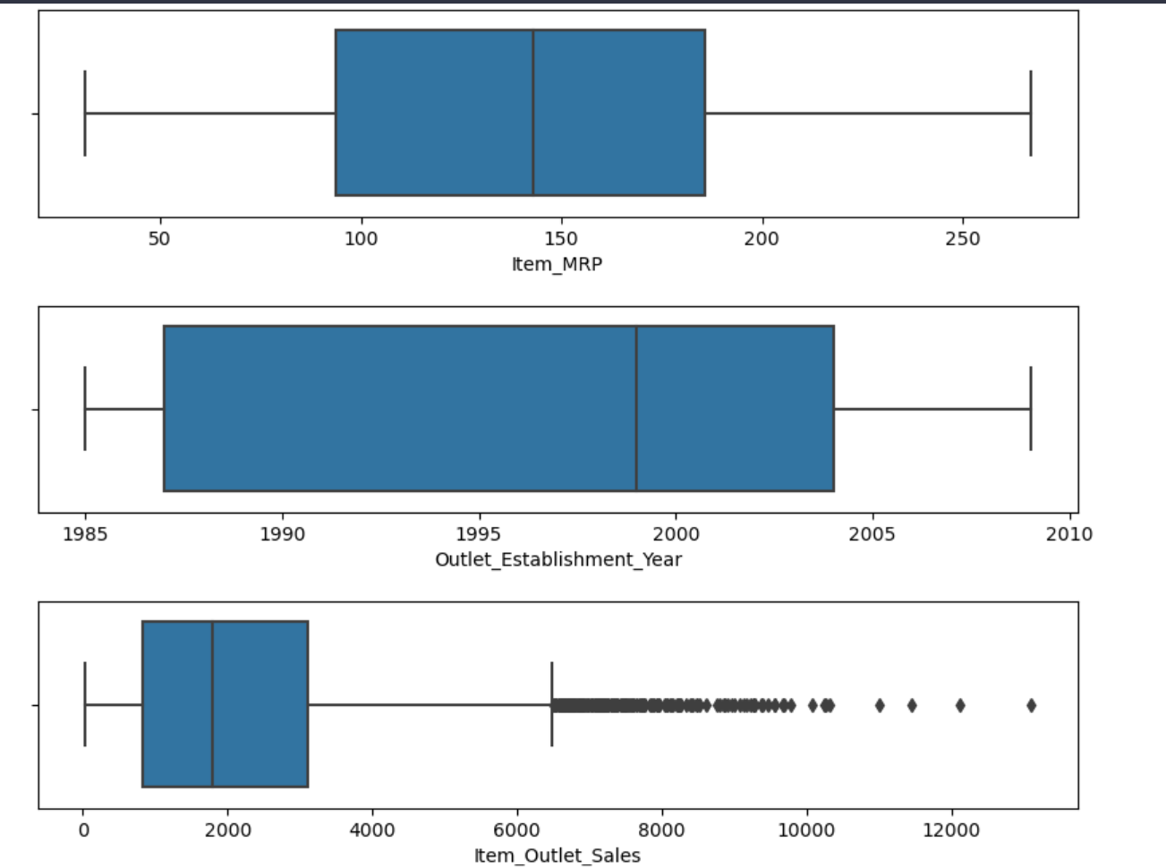
Data Preparation and Feature Engineering
Checking Outliers
Item_Visibility
Item_Outlet_Sale

Slide 15
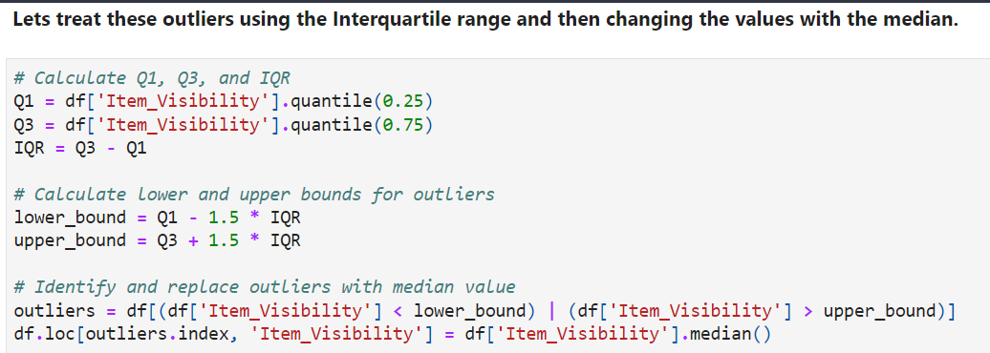
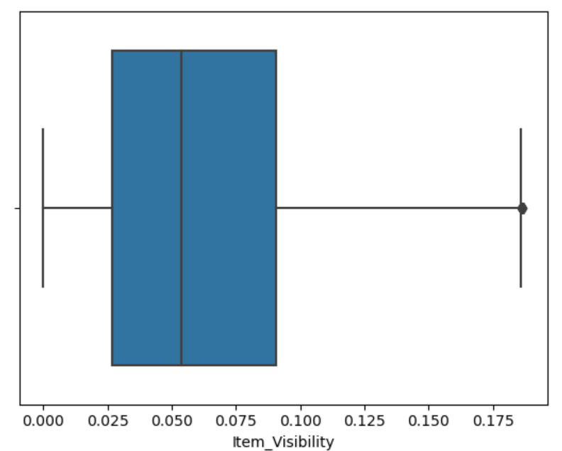
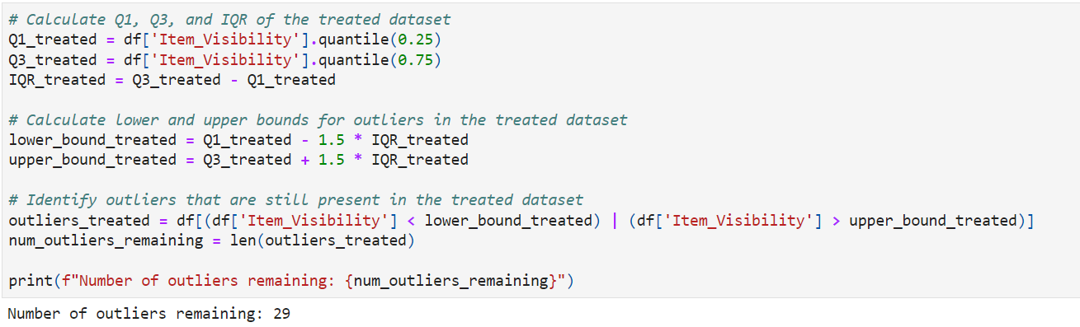
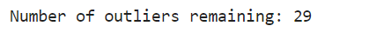
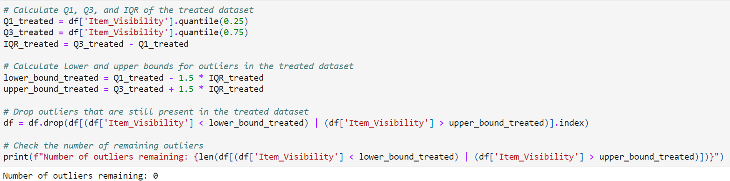
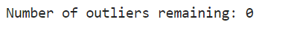
Data Preparation and Feature Engineering
Outliers removed from
Item_Visibility

Slide 16
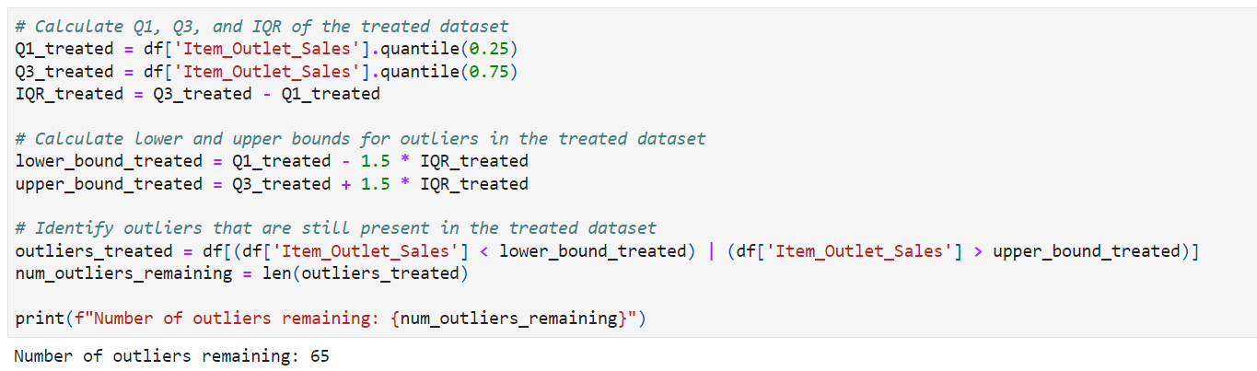
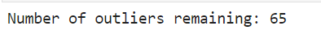
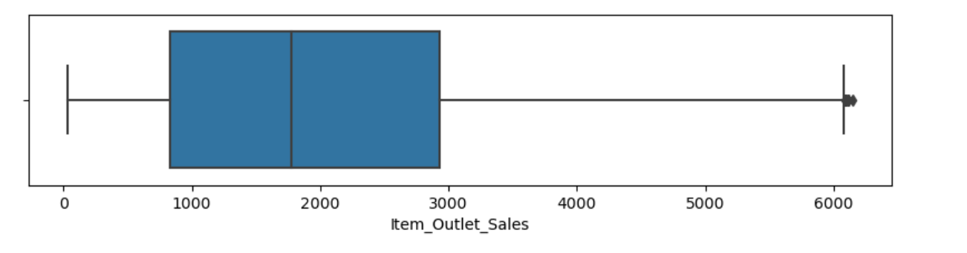
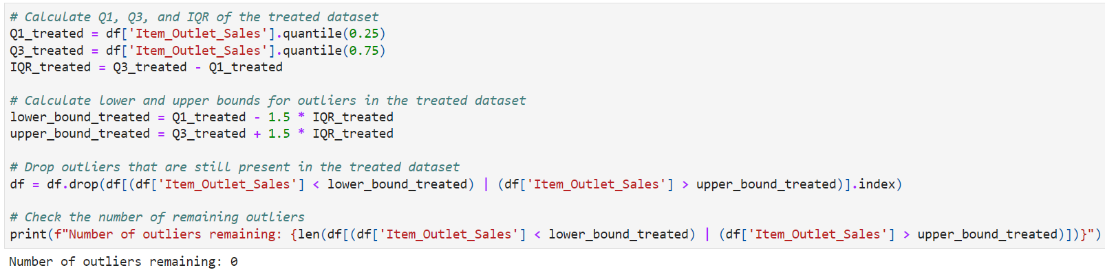
Data Preparation and Feature Engineering
Outliers removed from
Item_Outlet_Sales

Slide 17
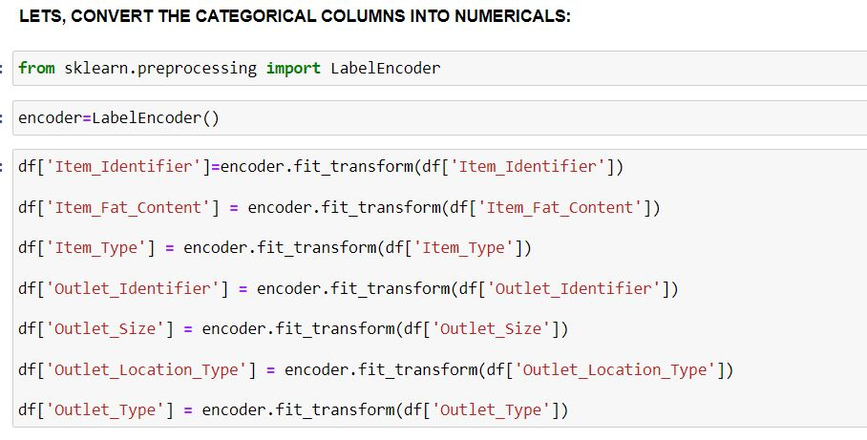
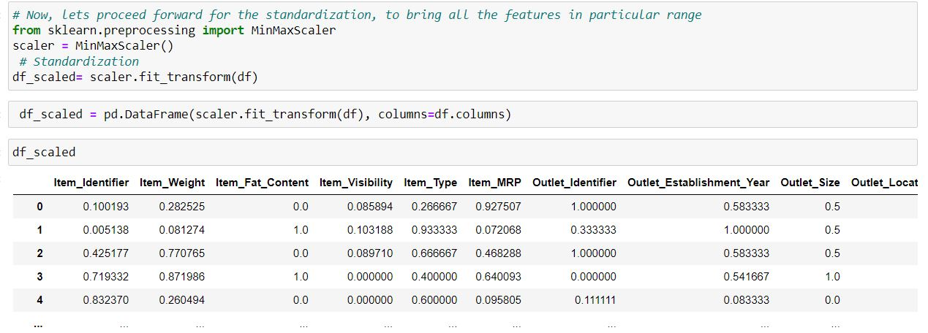
Data Preparation and Feature Engineering

Slide 18
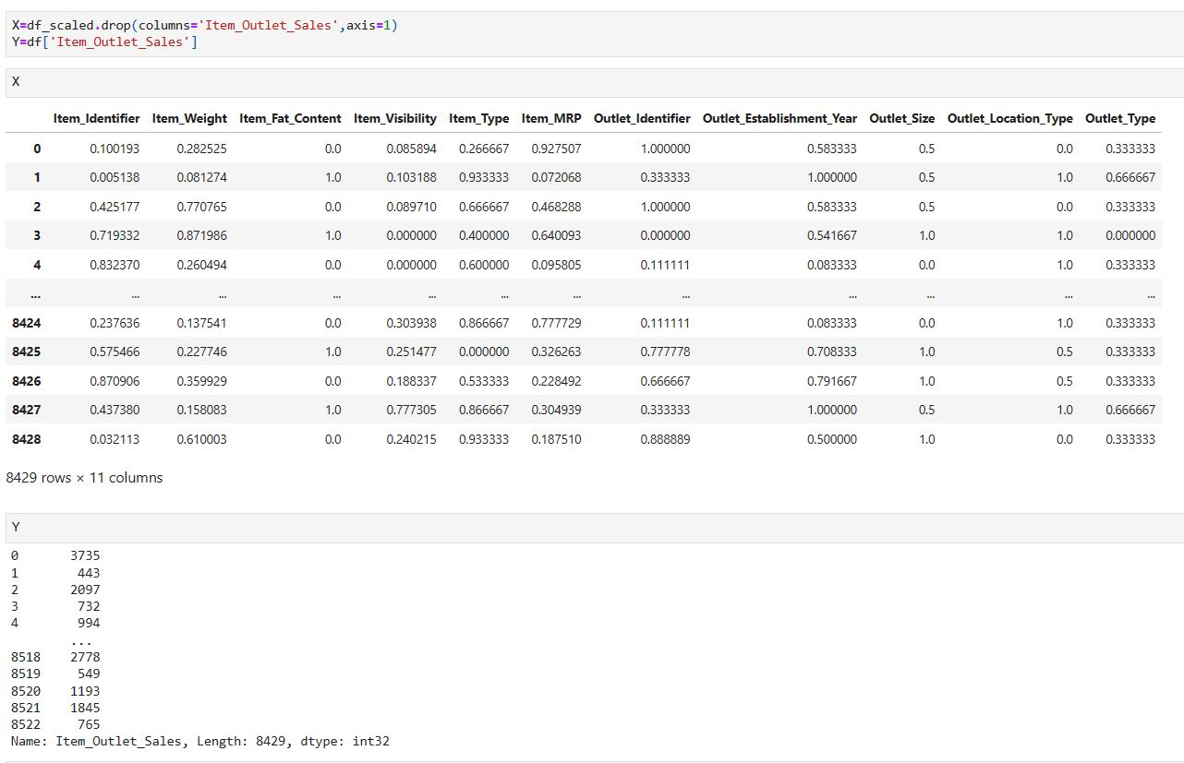
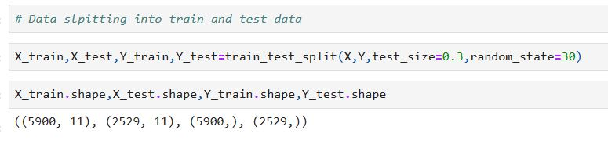
Data split:

Slide 19
Section 4: Modeling and pipelines creation
April 2023

Slide 20
Modelling
To predict the target variable, four different regression models were created.
These are the models:
Linear Regression
Decision Tree
Random Forest Regression
Xgboost
Each model was evaluated using four different metrics:
Mean Squared Error (MSE)
Root Mean Squared Error (RMSE)
Mean Absolute Error (MAE)
R-squared score

Slide 21
Pipeline Creation:
The team decided for 3 types:
1.Implementing Models only (without Ensemble Technique and Hyperparameter Tuning.)
2.Implementing model with Ensemble technique only.
3.Implementing model with both Ensemble technique and Hyperparameter Tuning.
And then comparing results for each of the pipeline……………

Slide 22
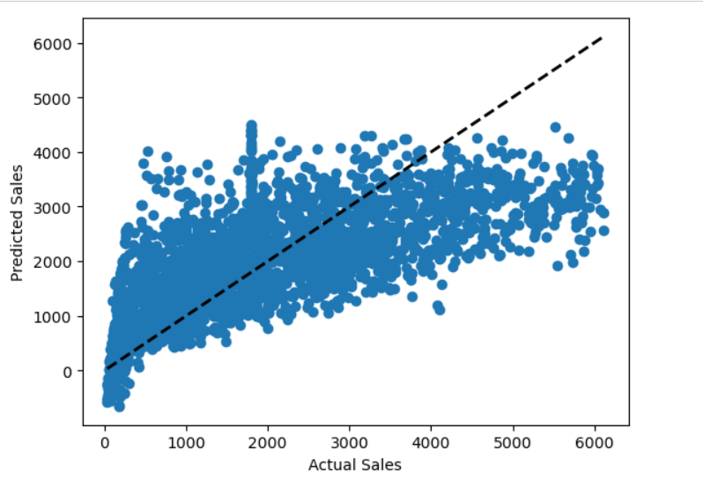
Linear Regression
The actual and predicted sales values are contrasted in this scatter plot. The ideal situation, in which the predicted values exactly match the actual values, is represented by the diagonal line.
The model's predictions are close to the actual values if the points are dispersed along the diagonal line. The model's predictions are not reliable if the points are far from the diagonal line.
In general, the model performs better the closer the points are to the diagonal line.
In this plot point are closer to diagonal line so model is better for sales prediction.

Slide 23
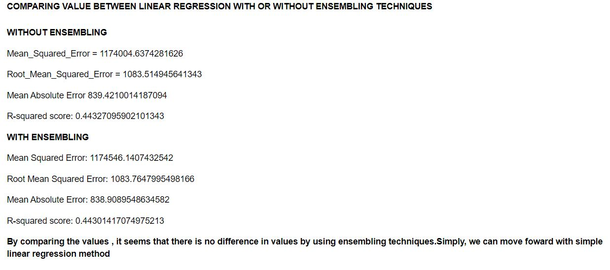
Linear Regression
(Without and with ensembling technique (Bagging Regressor)

Slide 24
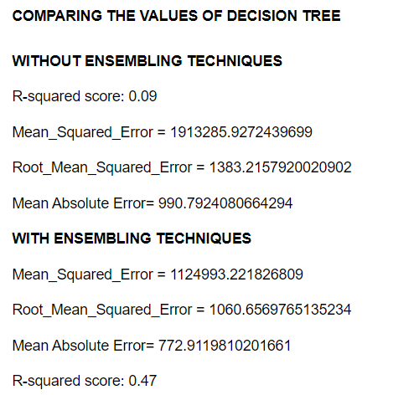
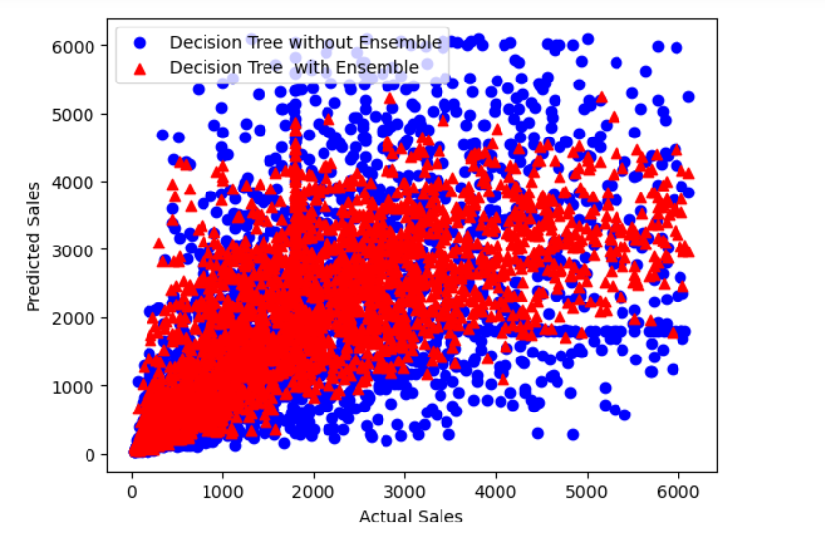
Decision Tree
(Without ensembling or with ensembling techniques(Bagging Regressor)

Slide 25
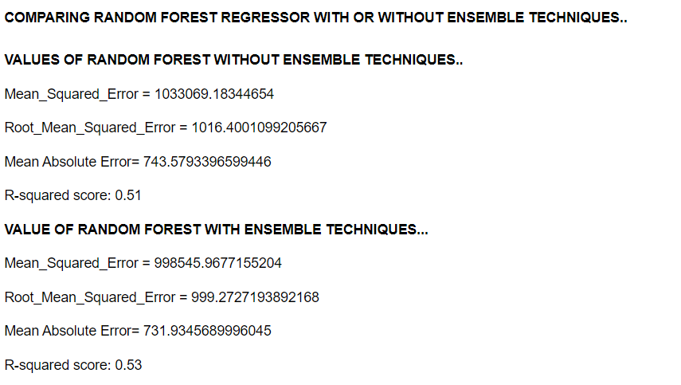
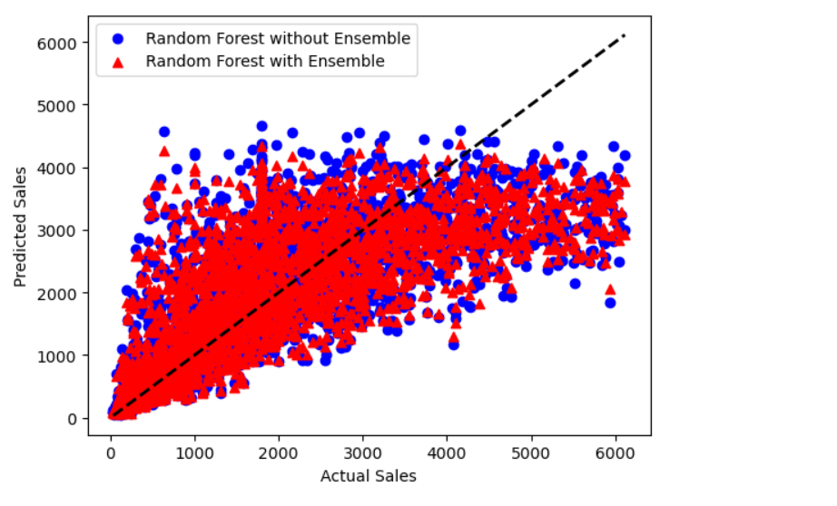
Random Forest Regressor
(With Ensemble Technique (Bagging regressor) and without Ensembling Techniques)

Slide 26
Hyperparameter Tuning(Using GridSearchCV)
The decision tree model with hyperparameter tuning performed better than the one without tuning with a higher R-squared score and lower error metrics. The decision tree bagging model with hyperparameter tuning outperformed the other models with the highest R-squared score and lowest errors in predicting sales.
Overall, the Hypertuned Random Forest with ensembling performed the best among other Random Forest models with the highest R-squared score and lowest error metrics. The Random Forest without ensembling had a lower R-squared score while the Random Forest with ensembling had a slightly higher score than the tuned version.
The XGBoost model with hyperparameter tuning outperformed the model without tuning with a higher R-squared score and lower error metrics, indicating better performance in predicting sales.

Slide 27
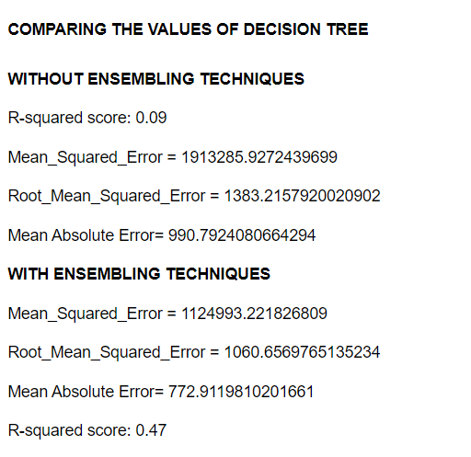
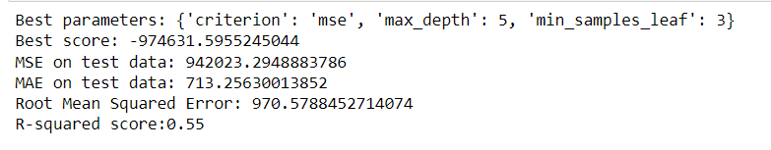
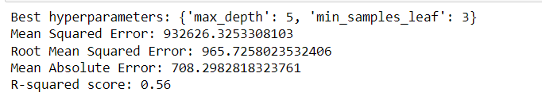
Decision Tree with Hyperparameter tuning
DECISION TREE WITHOUT HYPER PARAMETER TUNING
HYPERTUNING: DECISION TREE WITHOUT ENSEMBLE TECHNIQUES
HYPERTUNING: DECISION TREE WITH ENSEMBLE TECHNIQUES
In conclusion, the decision tree bagging model with hyperparameter tuning outperforms the other models discussed here, with the highest R-squared score and the lowest errors in predicting sales.

Slide 28
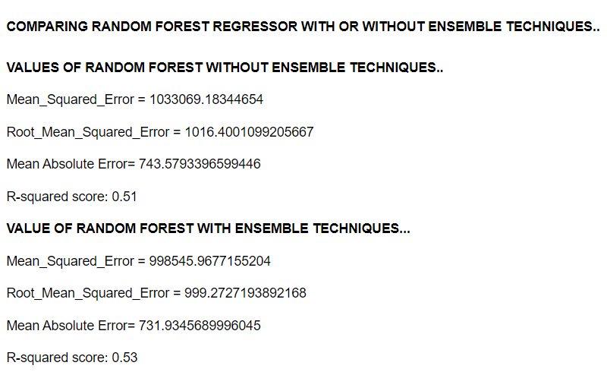
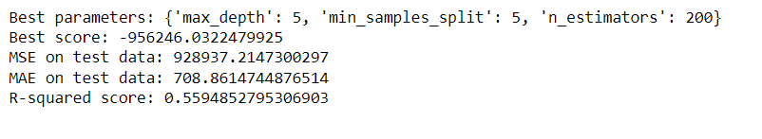
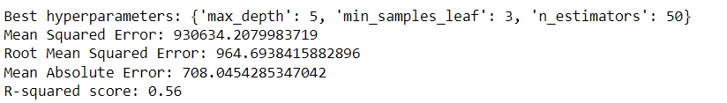
Random Forest With Hyperparameter tuning
RANDOM FOREST WITHOUT HYPER PARAMETER
TUNED RANDOM FOREST WITHOUT ENSEMBLE
TUNED RANDOM FOREST WITH ENSEMBLE TECHNIQUES
Overall, the Random Forest model with ensembling and hyperparameter tuning performs the best in this case for predicting sales.

Slide 29
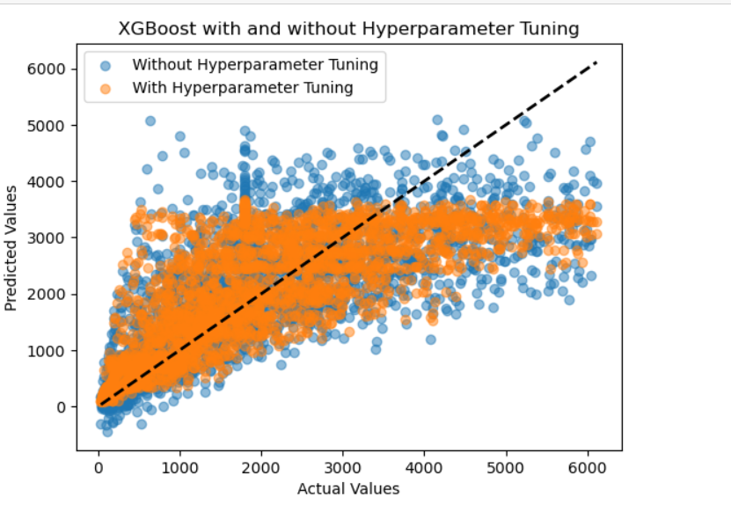
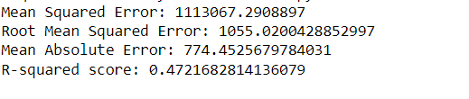
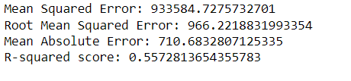
XGBOOST With Hyperparameter tuning
XGBOOST WITHOUT HYPER PARAMETER
XGBOOST WITH HYPER PARAMETER
As a result, compared to the XGBoost model without tuning, the XGBoost model with hyperparameter tuning is more accurate at forecasting sales.

Slide 30
Section 5: Model Evaluation and Selection
April 2023

Slide 31
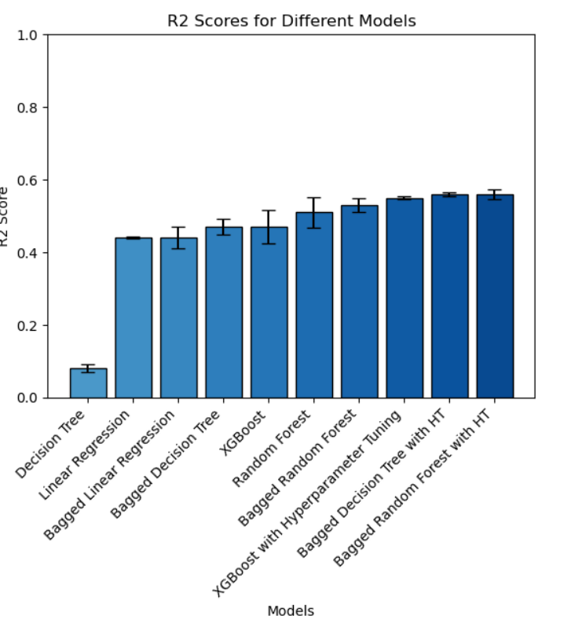
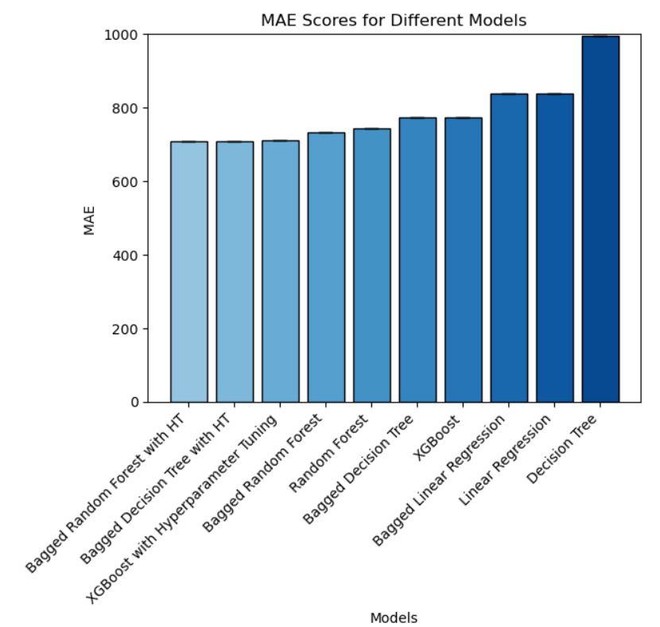
Model Evaluation and Selection
1
2

Slide 32
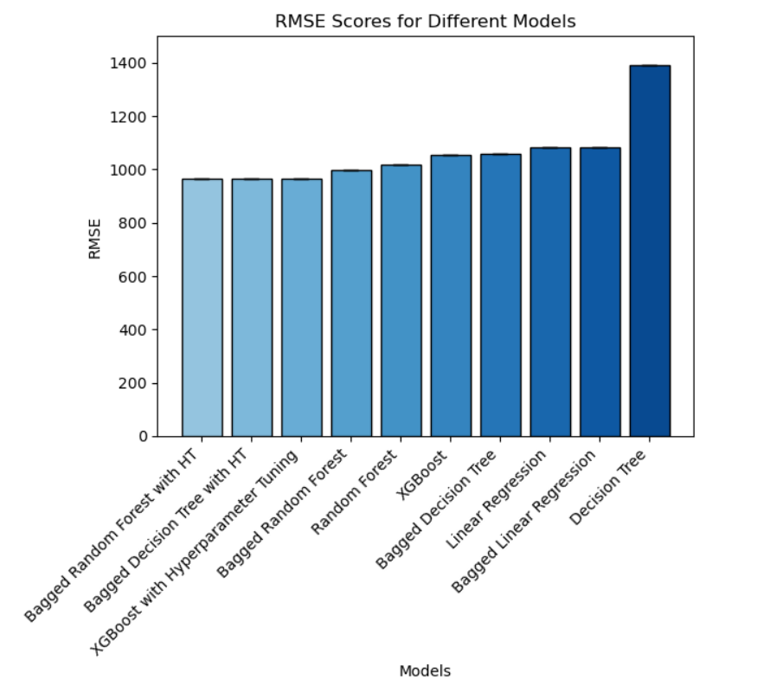
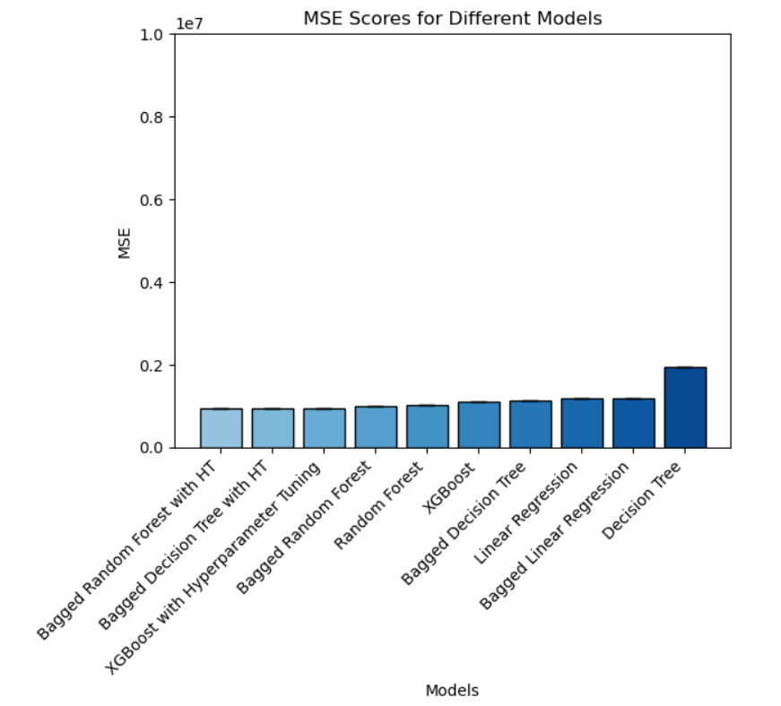
Model Evaluation and Selection
3
4

Slide 33
Section 6: Conclusion
April 2023

Slide 34
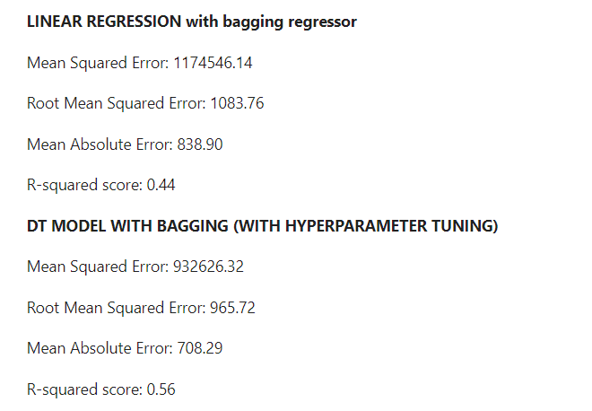

Conclusion
Based on the evaluation metrics, it appears that the Bagged Random Forest Regressor with Hyperparameter Tuning outperforms the other three models, with lower MSE, RMSE, and MAE and a higher R-squared score of 0.56. As a result, the Random Forest Regressor may be the most appropriate model for this dataset.

